Slide 1
XY Stitching and Z Alignment of the Liver Dataset
Ishaan Singh Chandok
September 12, 2022

Slide 2
Outline
Background on Liver Dataset
Important Algorithms
Overview of XY Stitching using SOFIMA
Z Alignment using SAToRI
Future Plans

Slide 3
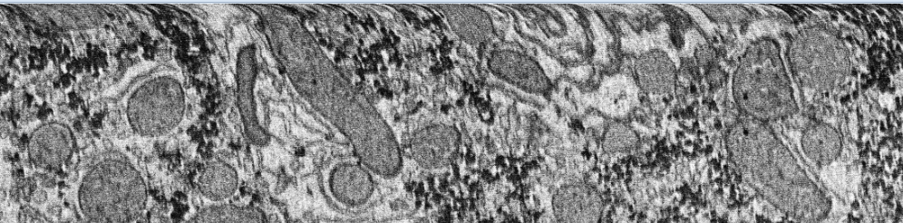
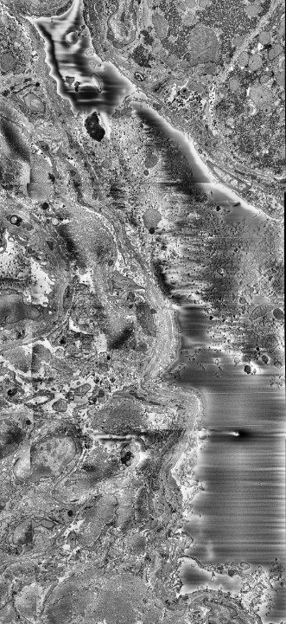
Properties of Liver Dataset
The human liver sections are imaged using a serial block-face scanning electron microscope (SBF-SEM)
CLAHE applied to improve contrast of raw images
Each tile has ideally ~10% overlap with neighbouring tiles, and each section is ~50 nm thick
Issues in the dataset include:
Warping at Edges
Charging
CLAHE = Contrast Limited Adaptive Histogram Equalization
Notes:
SB-SEM: The sections are cut in the SEM itself
Each image is 4000 x 4000 pixels
The charging was caused by resin being stuck in a blood vessel, and is present throughout the entire dataset
Unlike the heavy-metals used to stain the sample, resin is non-conducting, which causes this charging effect to occur
Unlike FIB-SEM (focused ion beam), the sections can be recovered and stored, allowing the sample to be re-imaged at a later date
Ideally, 10% overlap, but this number varies, and some sections do not overlap at all
Histogram Equalization
An image’s pixel values are confined to a certain range, which lies in a histogram
(Global) Histogram Equalization is basically stretching this histogram, allowing the pixels to span a wider range, improving the contrast of the image
However, performing a global operation like this might make some sections too dark or too bright
Adaptive Histogram Equalization makes this operation local by splitting the image into tiles and applying the operation within each tile (the tile grid size)
Contrast limiting prevents the histograms from becoming too large (the clip limit)

Slide 4
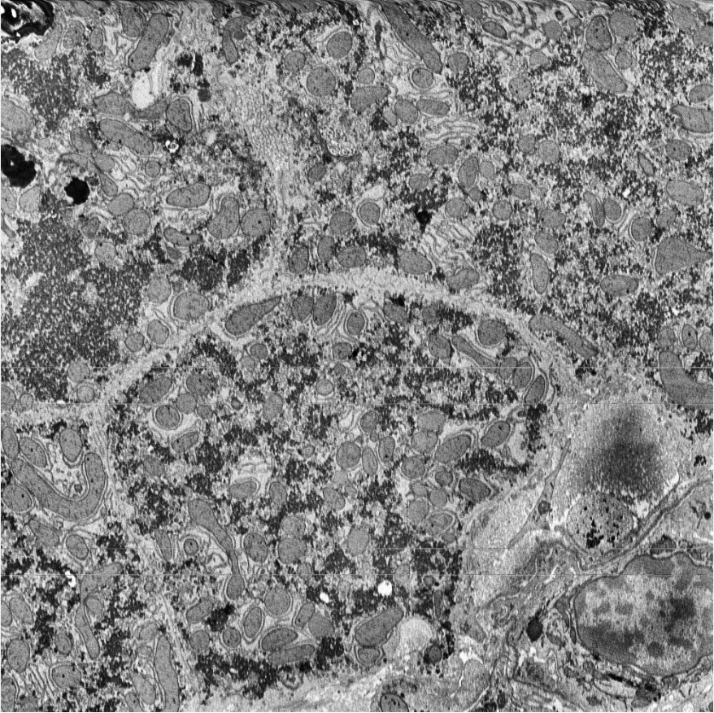
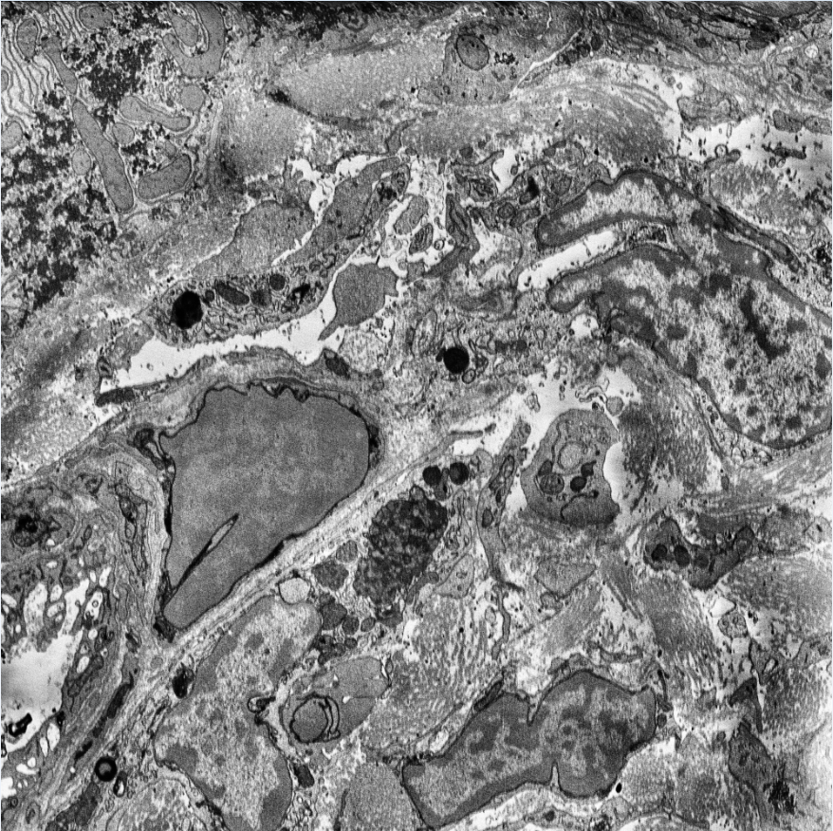
Top: Image 51, 16th Tile
Bottom: Image 51, 21st Tile
Low overlap and non-overlapping tiles
Notes:
It is nontrivial how much overlap is between these images
In coordinates, left = (3,1), right = (4,1), starting from (0,0)

Slide 5
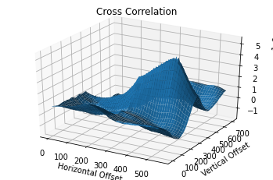
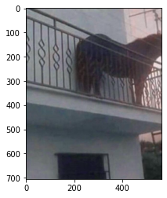
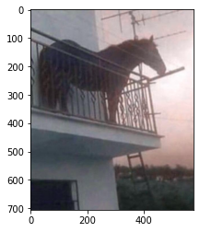
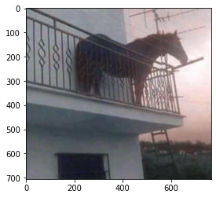
Cross-Correlation
Relies on normalized cross-correlation to match images
Implemented using Fourier transforms
Global Peak: (353, 463), Peak for Y = 0: (191, 0).
Notes:
For 1D signals, cross-correlation measures the similarity of two signals as a function of their phase shift
The FT of cross-correlation of f and g is F(f) F(g)*, where * is complex conjugation
Suffices to flip one image by 180 degrees (equivalent to CC), fft both images, then take the inverse fft of their product
The issue with cross-correlation is that we need to provide additional information, such as a range of overlapping regions, or whether the motion is horizontal/vertical translation only
The global peak is not necessarily the correct translational offset between images
The horse is named Juan

Slide 6
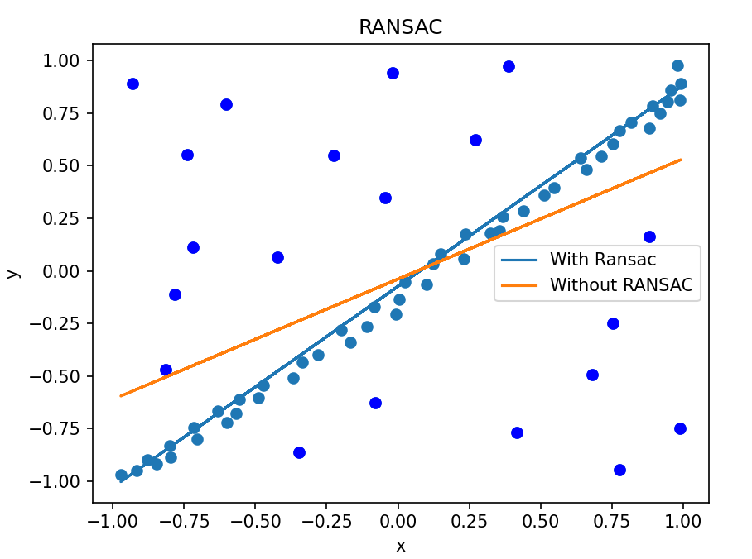
Scale Invariant Feature Transform (SIFT)
SIFT identifies scale and rotation invariant features in an image
Assigns a 128 dimension vector to each feature, called the descriptor
Finding an affine transformation between images amounts to matching descriptors and applying Random Sampling Consensus (RANSAC)

Slide 7
Spring-Mesh Relaxation
The spring-mesh system is relaxed using gradient descent with momentum
External spring connections are modeled with resting-length-0 springs
The objective function is the net potential energy of the system
For a system made of Hookean springs, minimizing the potential energy is equivalent to finding the configuration such that the net force on each node is 0

Slide 8
Overview of XY Stitching

Slide 9
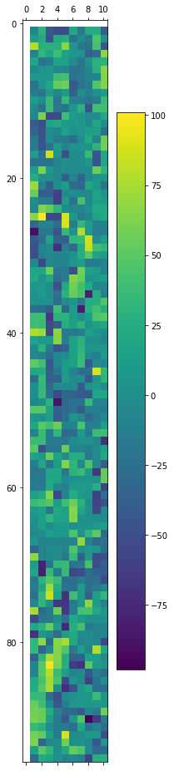
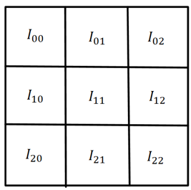
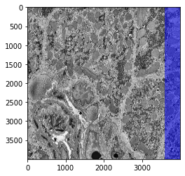
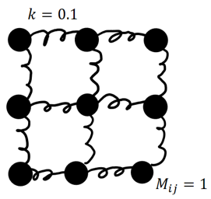
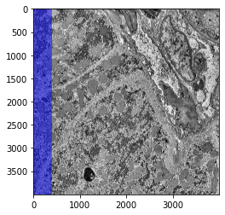
SOFIMA: Scalable Optical Flow-based Image Montaging and Alignment
Coarse Alignment
Fine Alignment
(Find fine flow field between matching regions in each tile)
Left Image
(Find coarse offsets between tiles)
Right Image

Slide 10
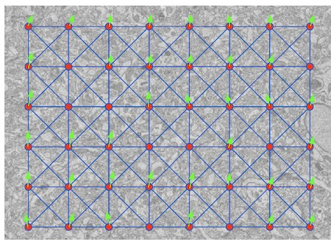
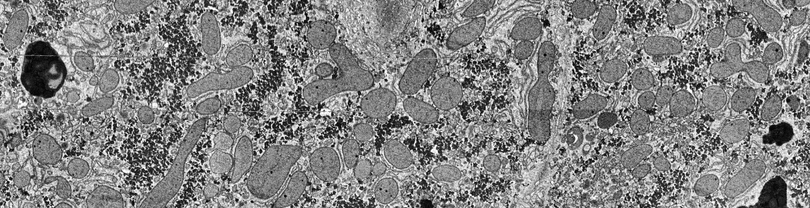
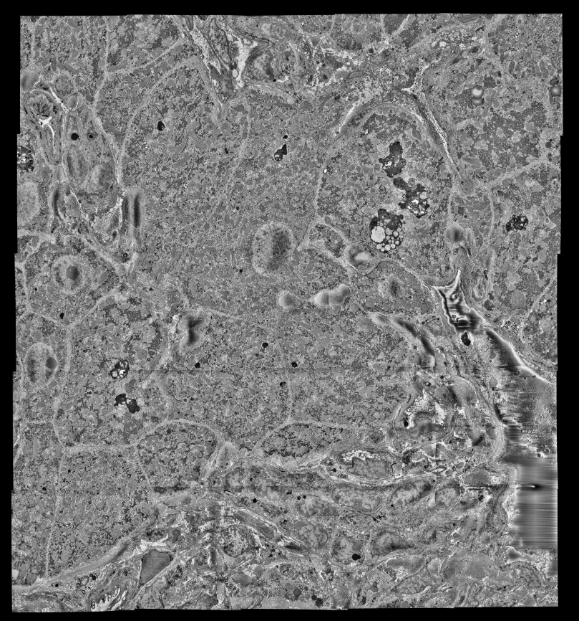
SOFIMA: Scalable Optical Flow-based Image Montaging and Alignment
Optimization
Rendering
Use spring-mass system to optimize fine flow fields, image taken from [1]
Render image, Layer 0 shown above
Layer 0

Slide 11
Overview of Z Alignment

Slide 12
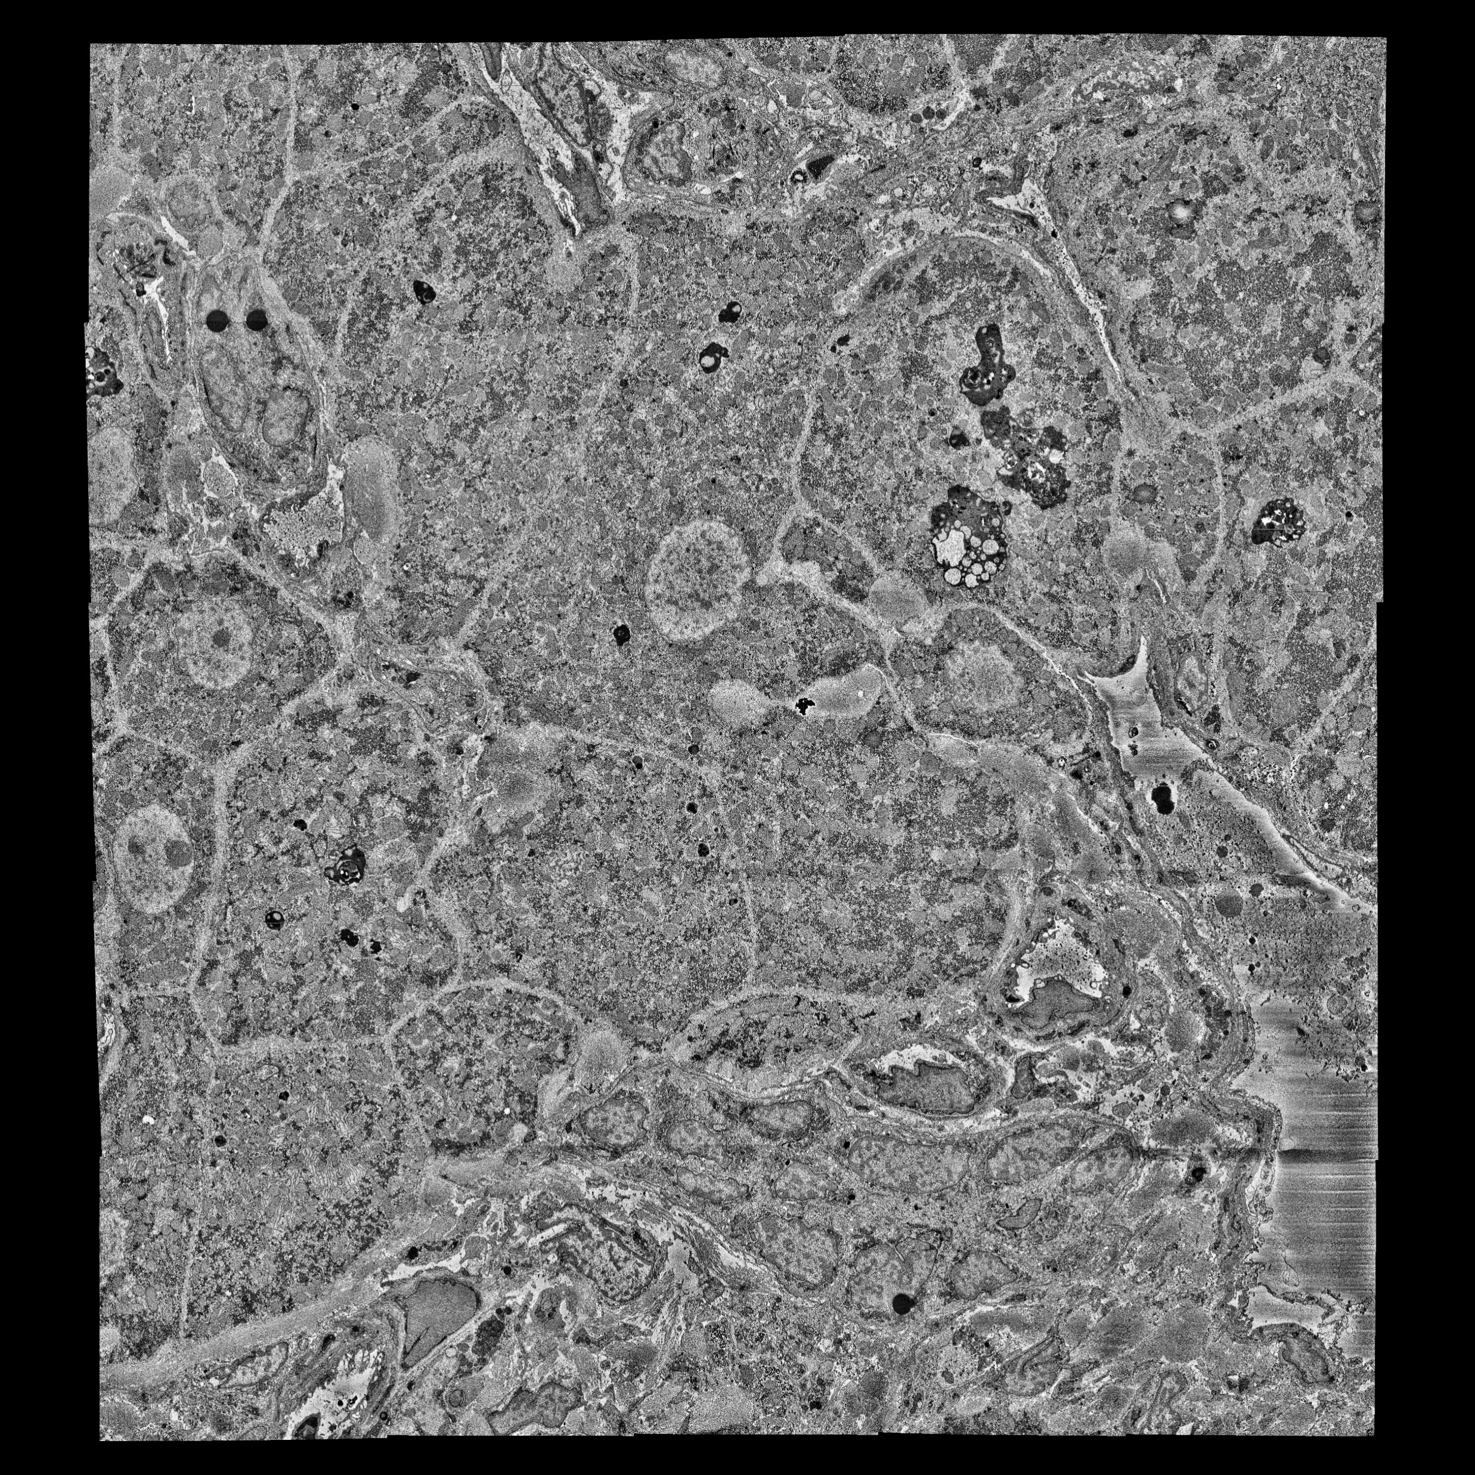
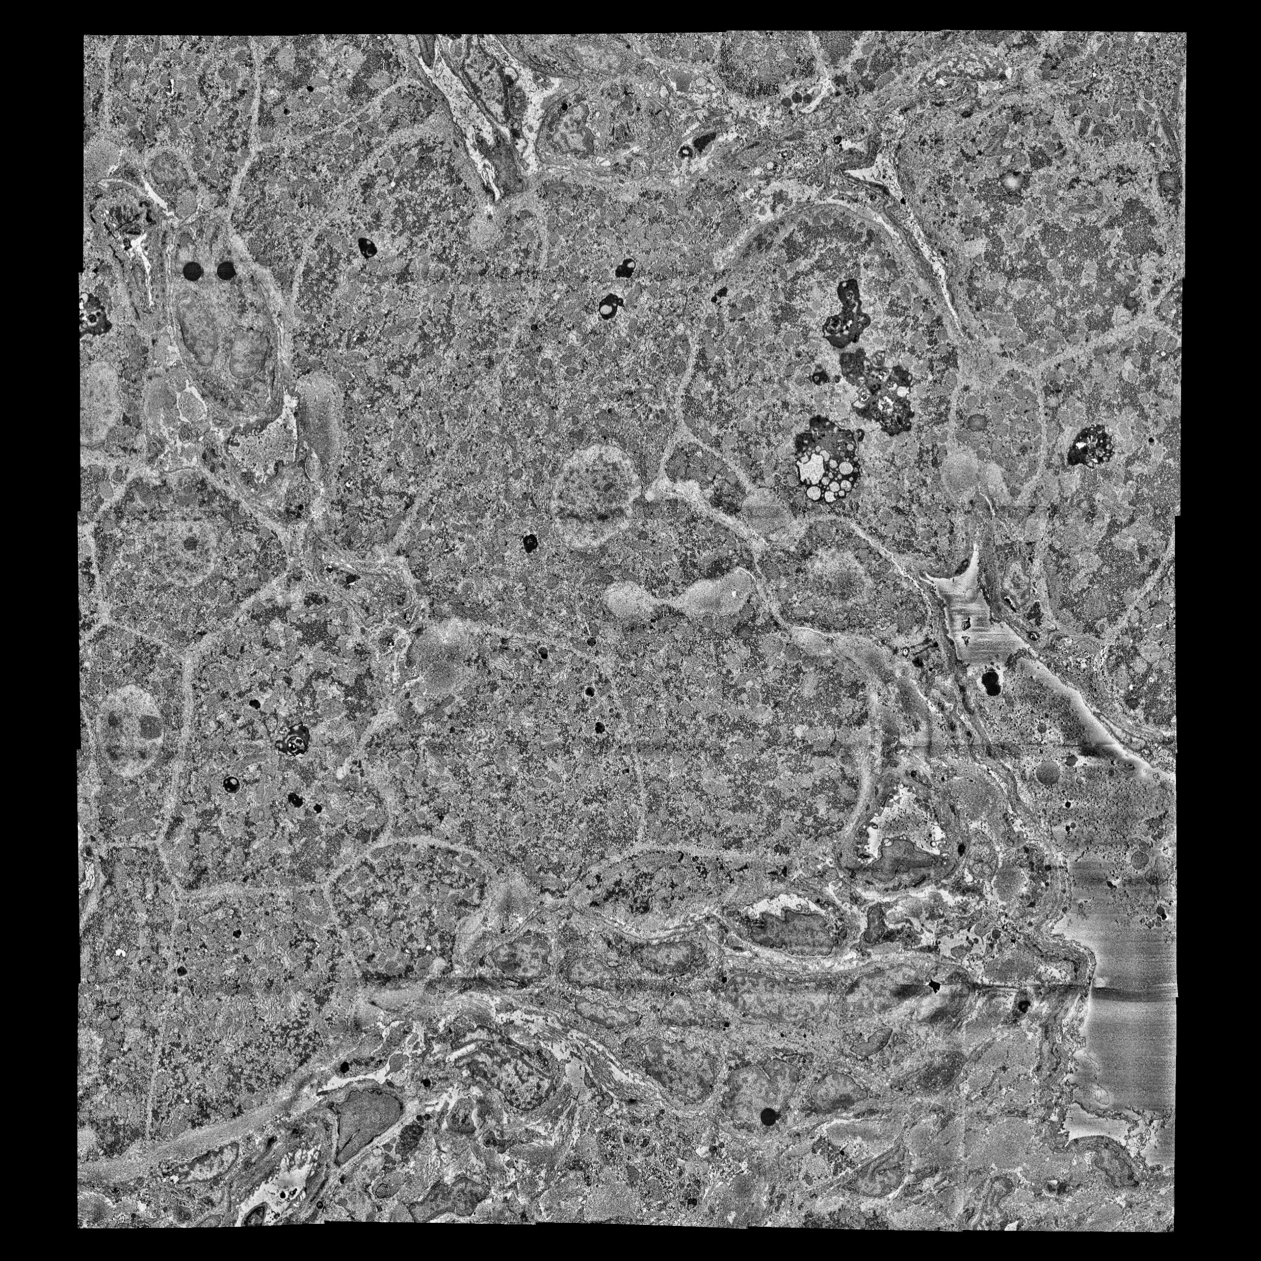
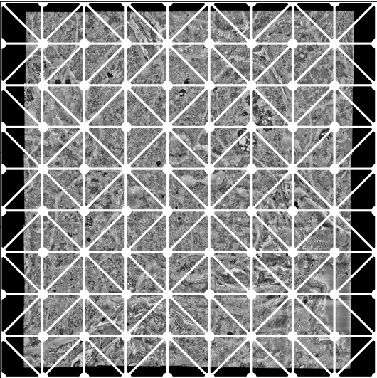
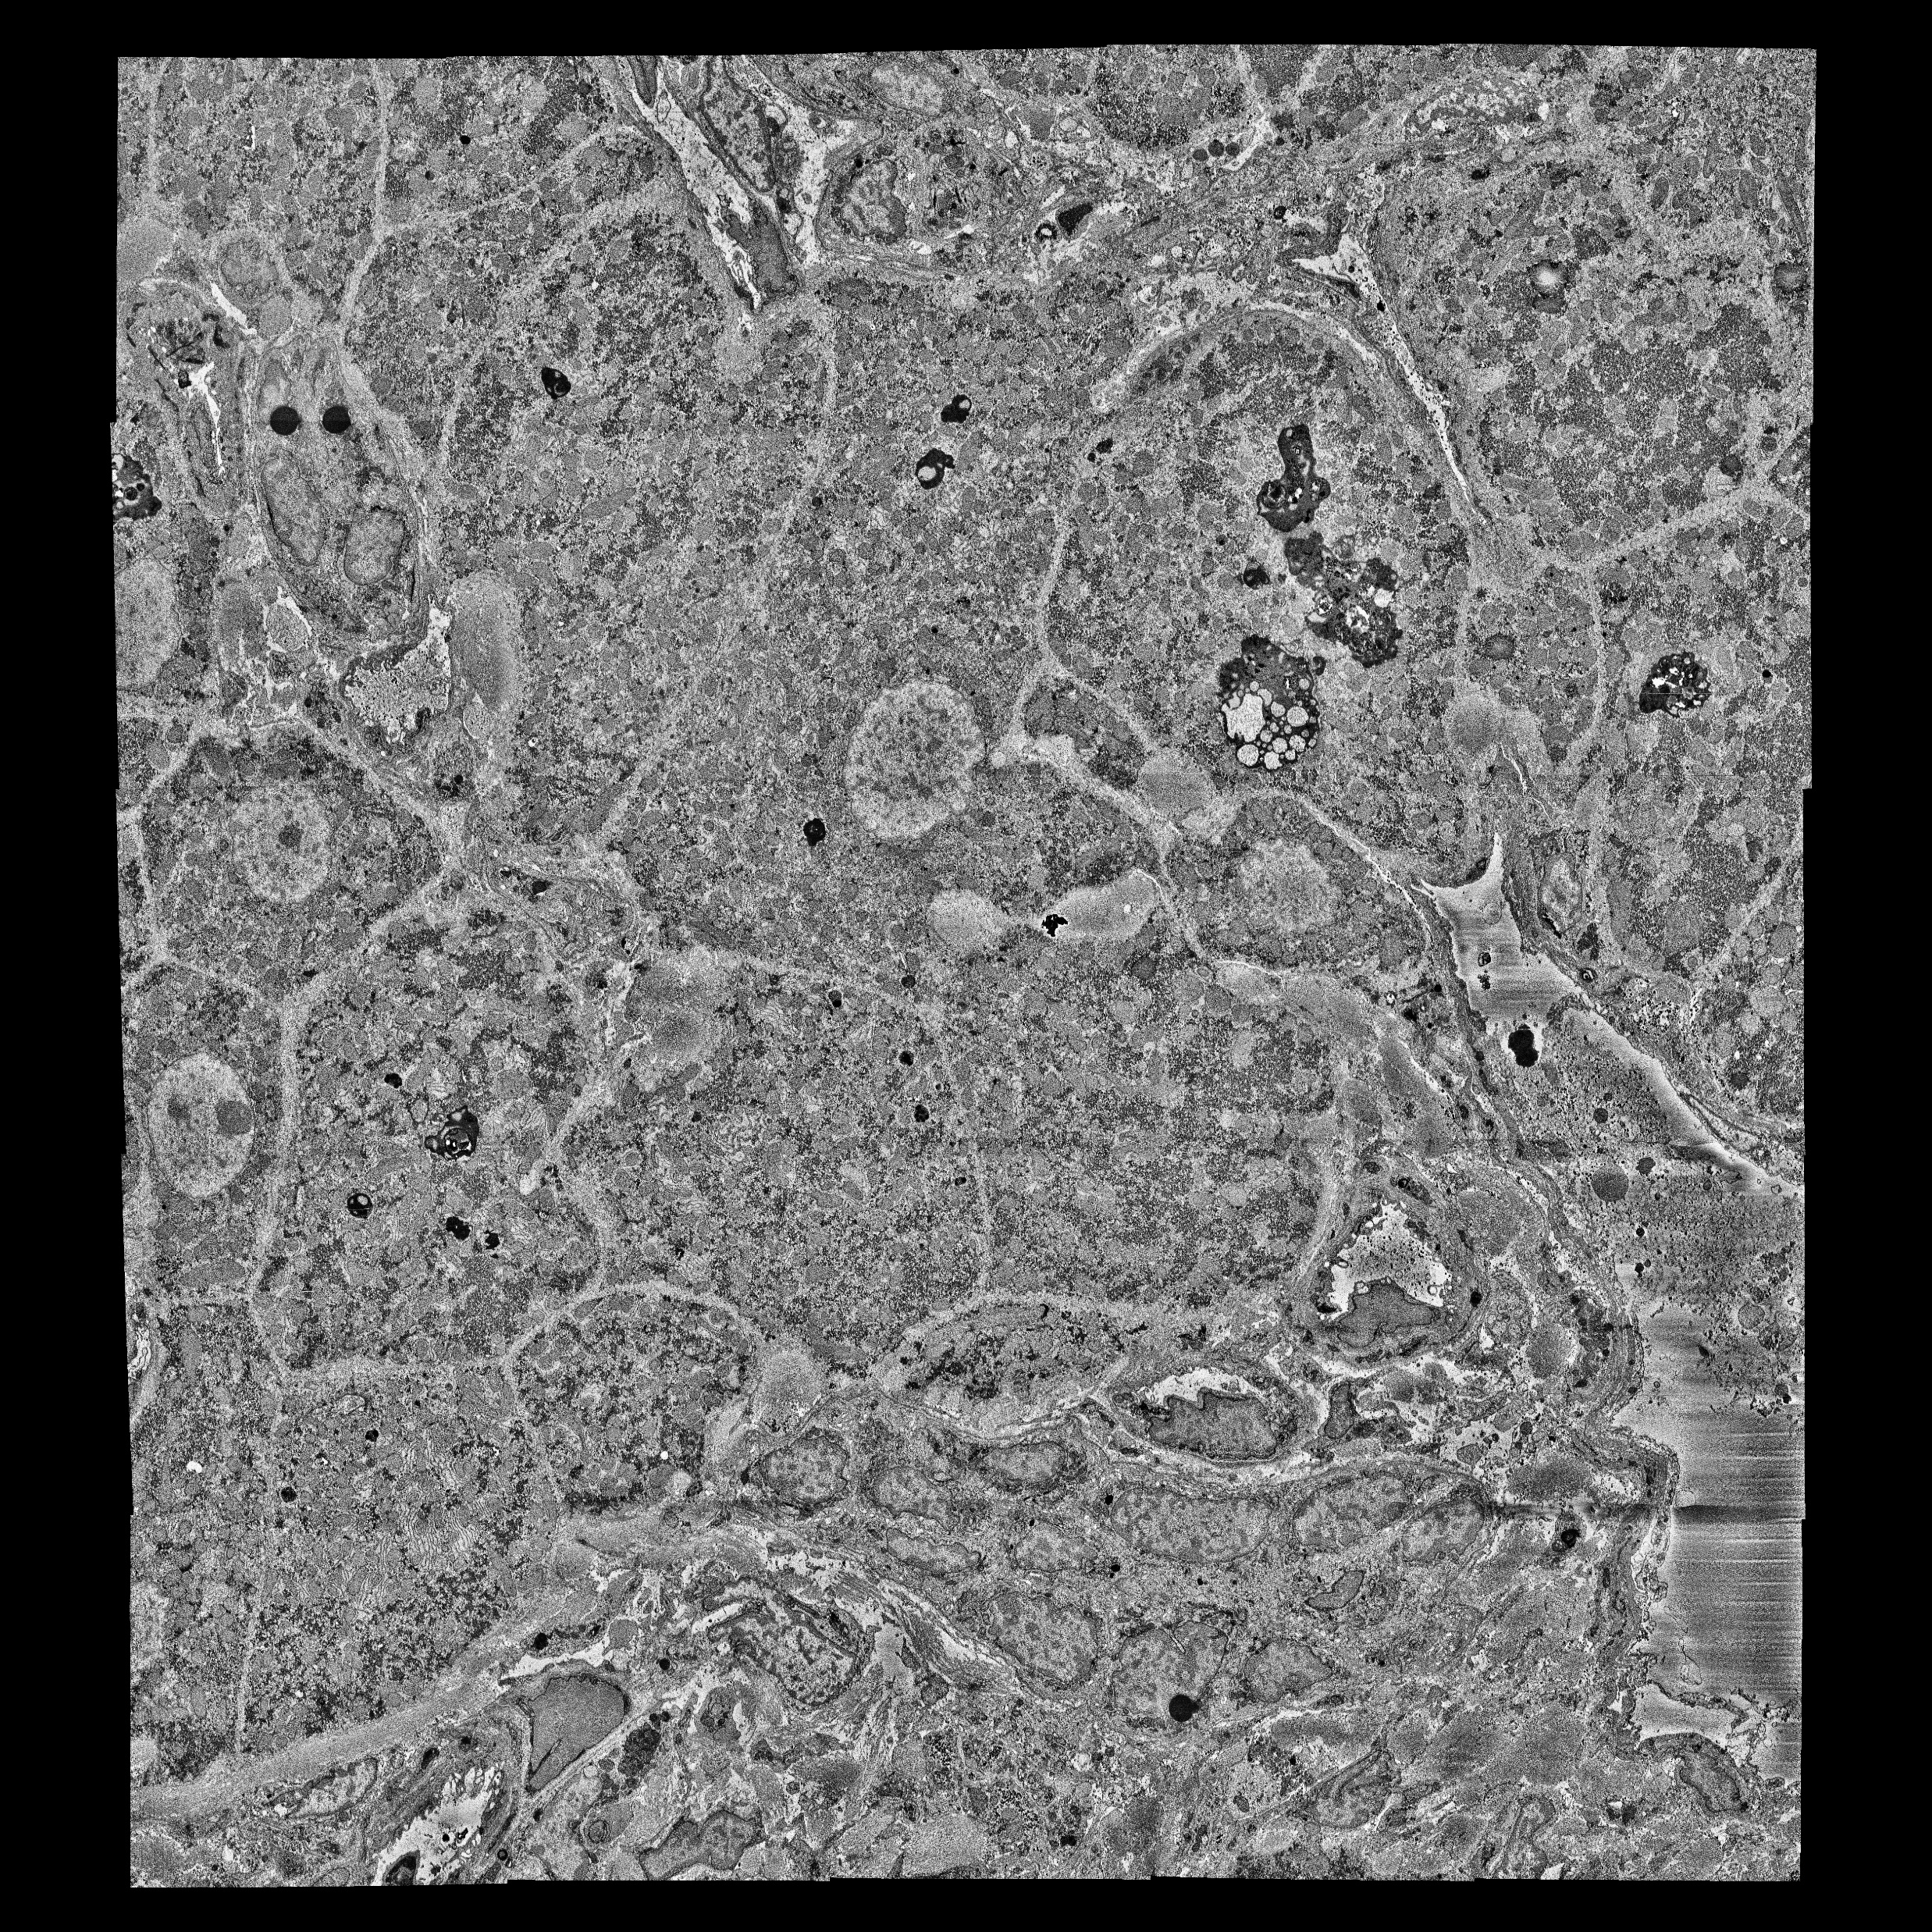


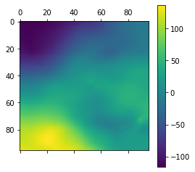
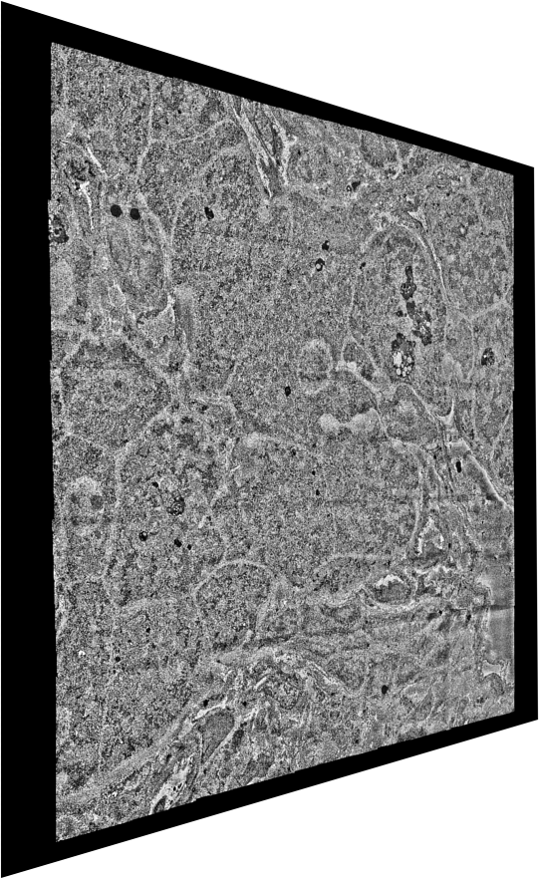
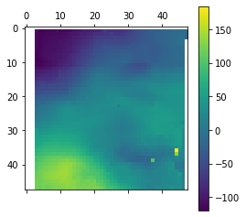
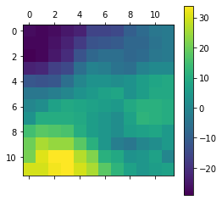
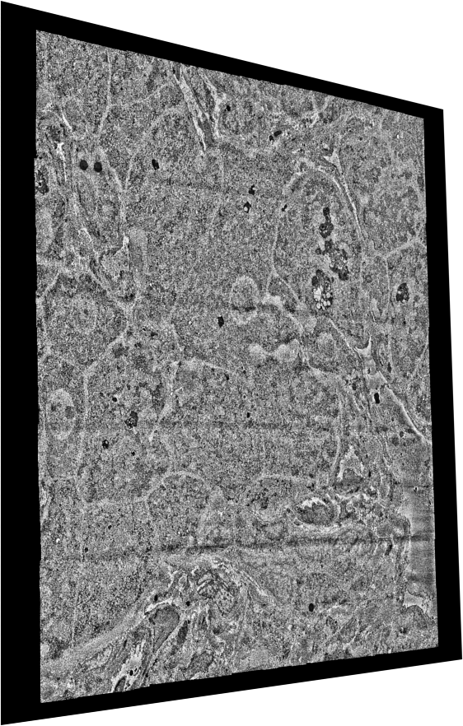
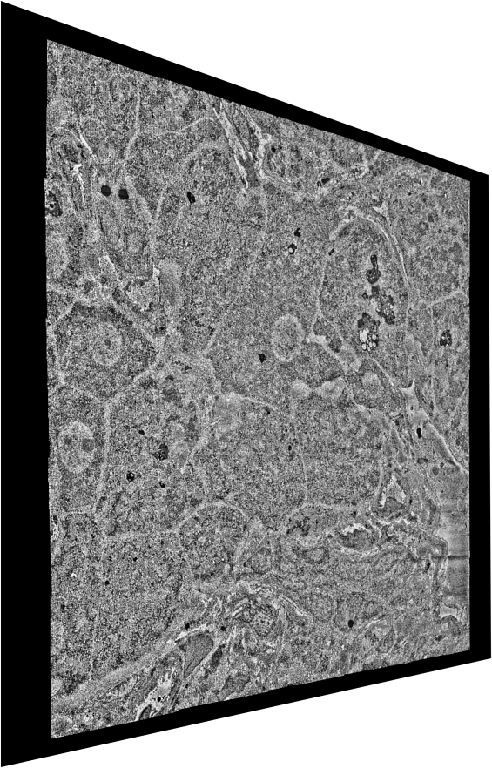
SAToRI: Stitching and Alignment Tools for High-Resolution Images
Global Alignment
Rough Alignment
Rough Optimization
(Image modelled as a spring-mesh system with connections to neighbouring z-layers)
(Affine motion between images)
(Matching points in downsampled images)
Rendering
Fine Optimization
Fine Alignment
(Full-resolution image stacks)
(Relaxed flow fields)
(Fine flow fields between images)

Slide 13
Rough Z Alignment

Slide 14
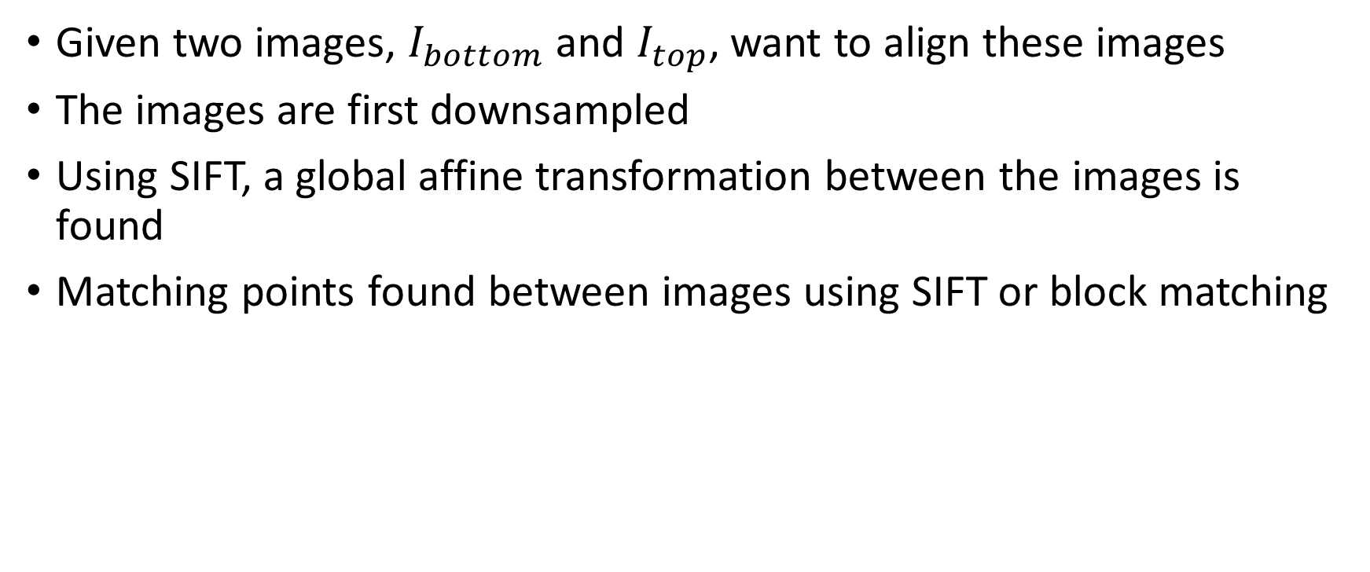
Overview of Rough Z Alignment
Given two images, $I_{bottom}$ and $I_{top}$, want to align these images
The images are first downsampled
Using SIFT, a global affine transformation between the images is found
Matching points found between images using SIFT or block matching
Notes:
Technical Limitations of Z-Alignment
Images differ a lot
Cannot perform cross-correlations on large images without using lots of memory

Slide 15
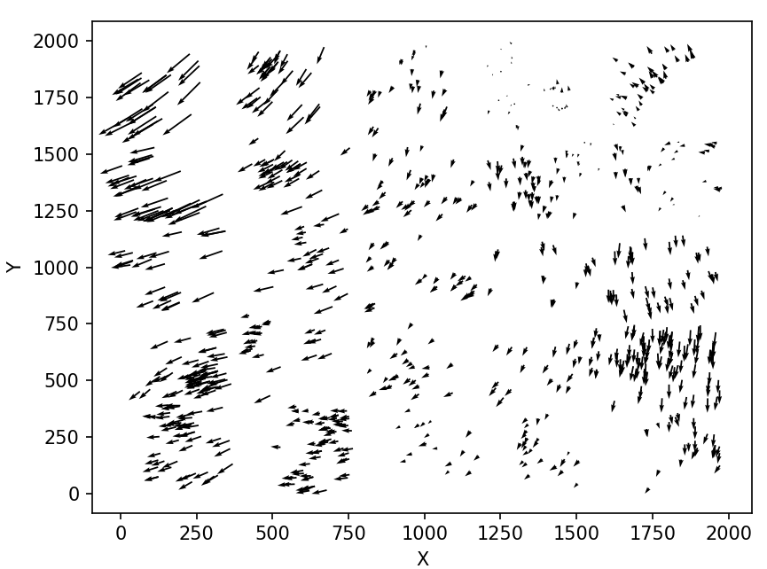
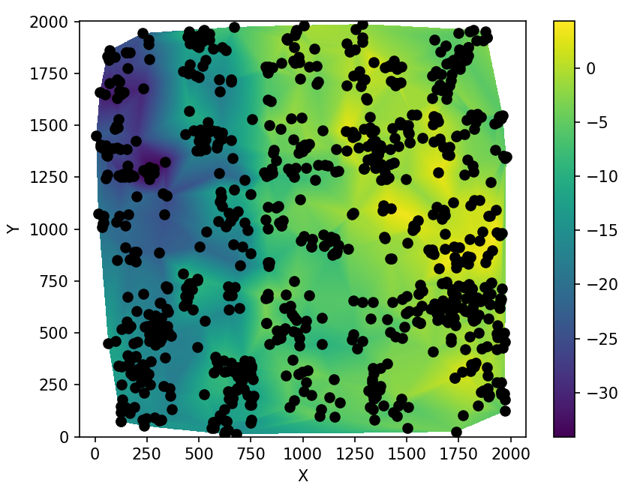
Matching Points via SIFT
Displacement Map
Horizontal Displacements on Image
Notes:
Use SIFT matching points to assign displacement vectors
Use local RANSAC to filter displacements, assuming that the transformation is locally affine
Perform bilinear interpolation to estimate a transformation on entire image

Slide 16
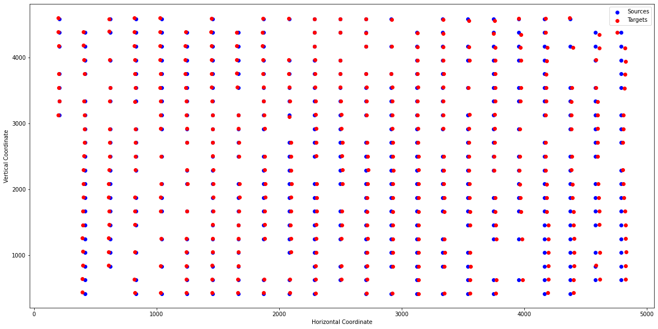
Matching points via cross-correlation

Slide 17
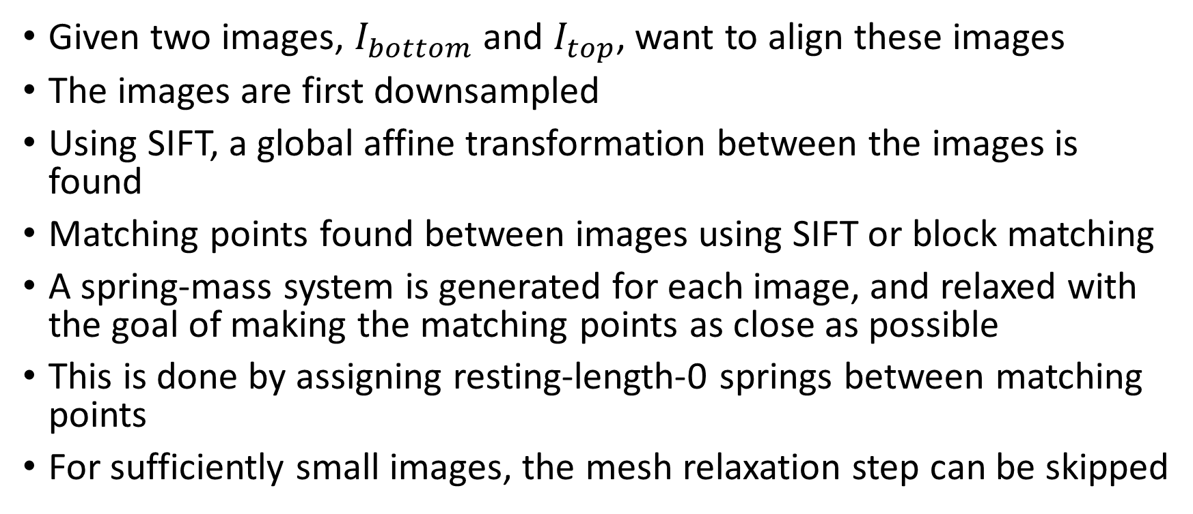
Overview of Rough Z Alignment
Given two images, $I_{bottom}$ and $I_{top}$, want to align these images
The images are first downsampled
Using SIFT, a global affine transformation between the images is found
Matching points found between images using SIFT or block matching
A spring-mass system is generated for each image, and relaxed with the goal of making the matching points as close as possible
This is done by assigning resting-length-0 springs between matching points
For sufficiently small images, the mesh relaxation step can be skipped
Notes:
Technical Limitations of Z-Alignment
Images differ a lot
Cannot perform cross-correlations on large images without using lots of memory

Slide 18
Fine Z Alignment

Slide 19
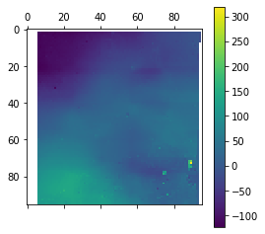
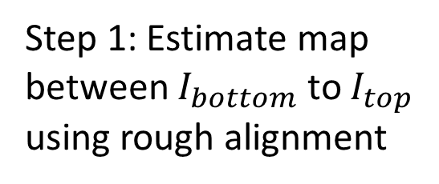
Computing Flow Map
Goal: Given $I_{bottom}$ and $I_{top}$, want to find a flow map between these images
Step 1: Estimate map between $I_{bottom}$ to $I_{top}$ using rough alignment
Step 2: Iterate until flow map has a fine resolution (filter intermediate maps)
Step 3: Filter false matches and relax system
Notes:
Step 1: Flow map found from img2 to img1
The stride controls the resolution of the map, the patch_size controls the patches that are correlated and the batch_size controls parallelism
Step 2: Flow map is filtered
Step 3: A spring-mesh system smooths out the flow map
Without smoothing, applying a discontinuous flow would cause pixels to disappear in the actual image

Slide 20
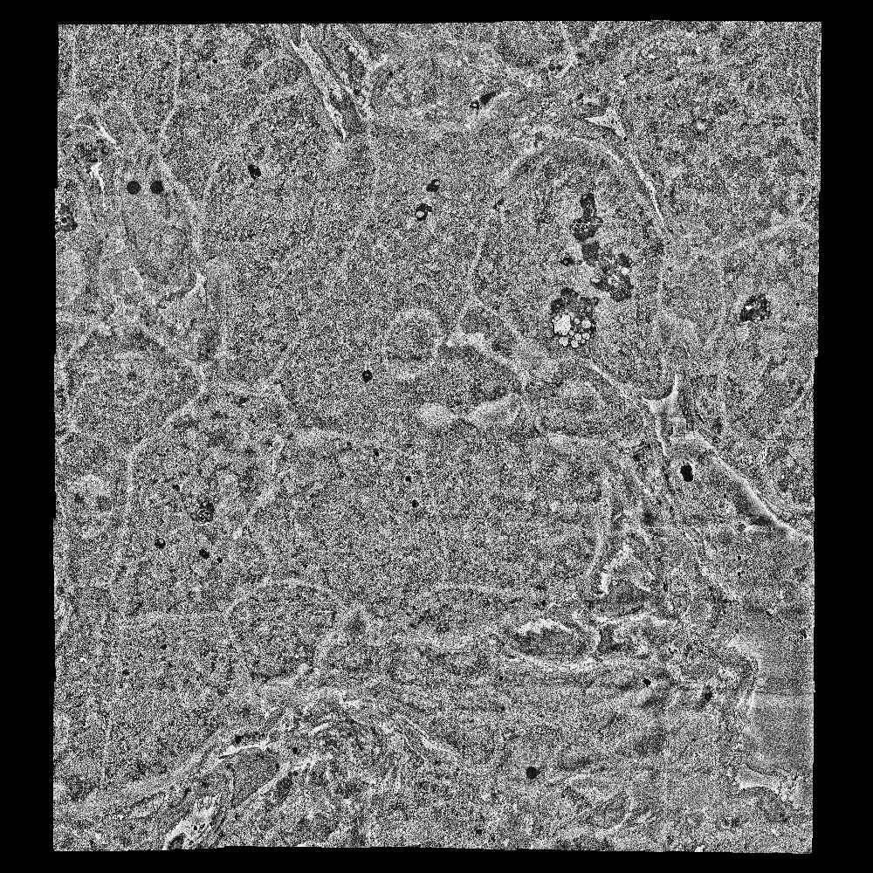
Layers 51 to 81

Slide 21
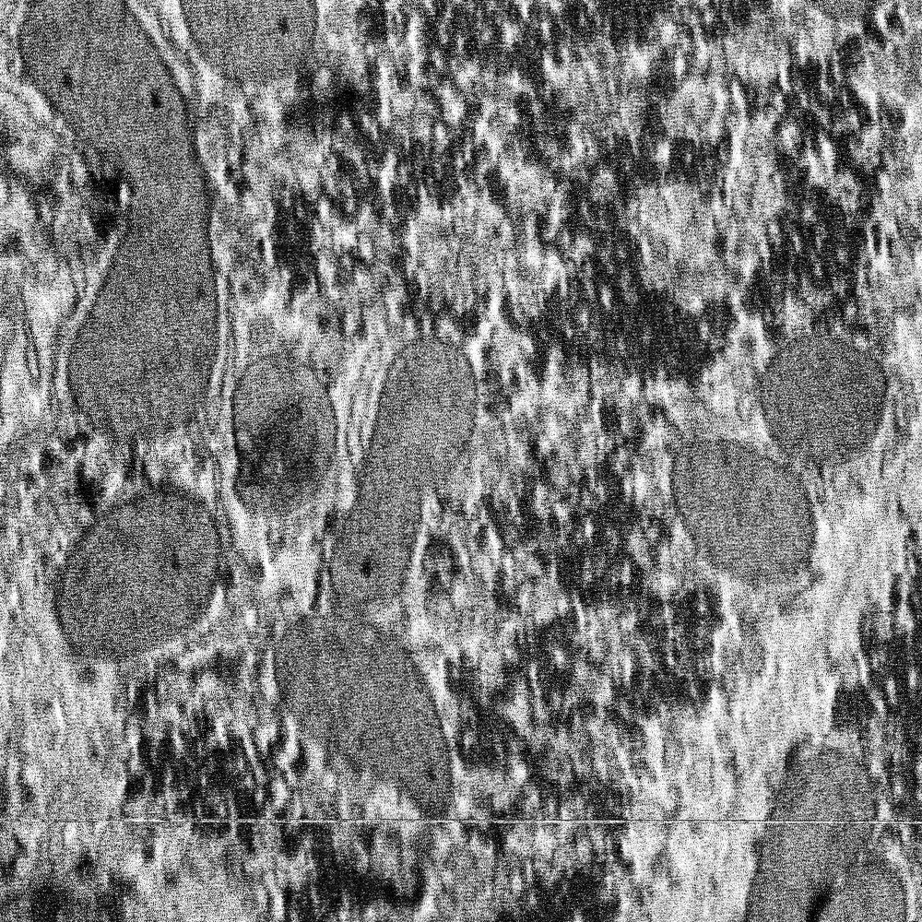
Layers 51 to 81 (zoom)

Slide 22
Future Plans
Complete implementation of 3D spring-mesh system
Calculate residuals between matching points as a method to determine poorly aligned images
Correct local wrinkling (convergence of mesh, 3D mesh, etc.)

Slide 23
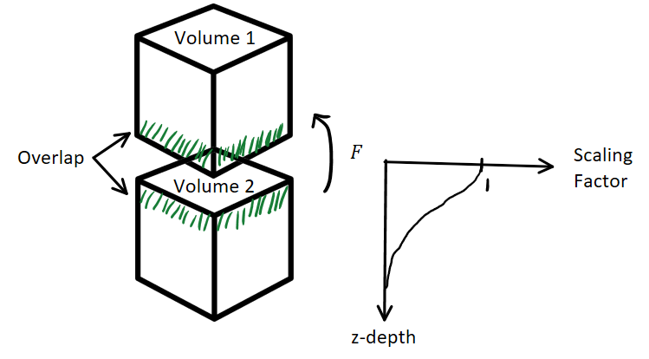
Block Alignment: Align overlapping batches by calculating a consensus flow map, and applying the flow in a decaying manner

Slide 24
Future Plans
Complete implementation of 3D spring-mesh system
Calculate residuals between matching points as a method to determine poorly aligned images
Correct local wrinkling (convergence of mesh, 3D mesh, etc.)
Block Alignment: Align overlapping batches by calculating a consensus flow map, and applying the flow in a decaying manner
Remove SOFIMA dependency
Consolidate our SEM adult C. elegans datasets

Slide 25
Resources
[1] https://github.com/google-research/sofima
[2] https://github.com/adisuissa/mb_aligner

Slide 26
Acknowledgements
Zhen Lab
Prof. Mei Zhen
Dr. Ben Mulcahy
Dr. Tosif Ahamed
Dylan Fong
All members of Zhen Lab ☺
Lichtman Lab
Dr. Yuelong Wu
Dr. Shuohong Wang
Bader Lab
Ronald Xie

